Slide 1
3-1-1 NYC Data
GROUP - 8
Fenchenko, Denys Matta, Amani Deepthi Mehta, Mahima
(df1911) (am10620) (mm11527)
Github Link : https://github.com/mahimamehta/big_data_project

Slide 2
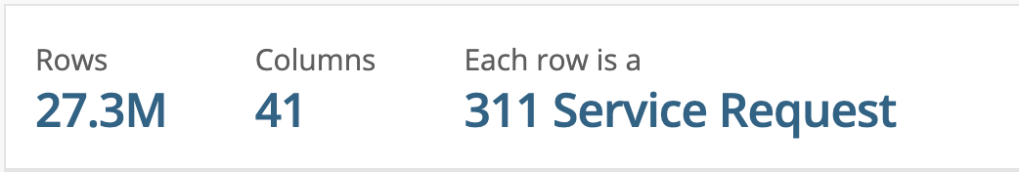
What is 3-1-1 NYC Service Requests Data?
It is how you report issues within NYC, things like potholes in the road, trees down, trash problems, noise and how some cities rely on the community to help report homeless that might be in need of assistance.
311 is a hotline number for non-emergency complaints.

Slide 3





Tools and languages

Slide 4
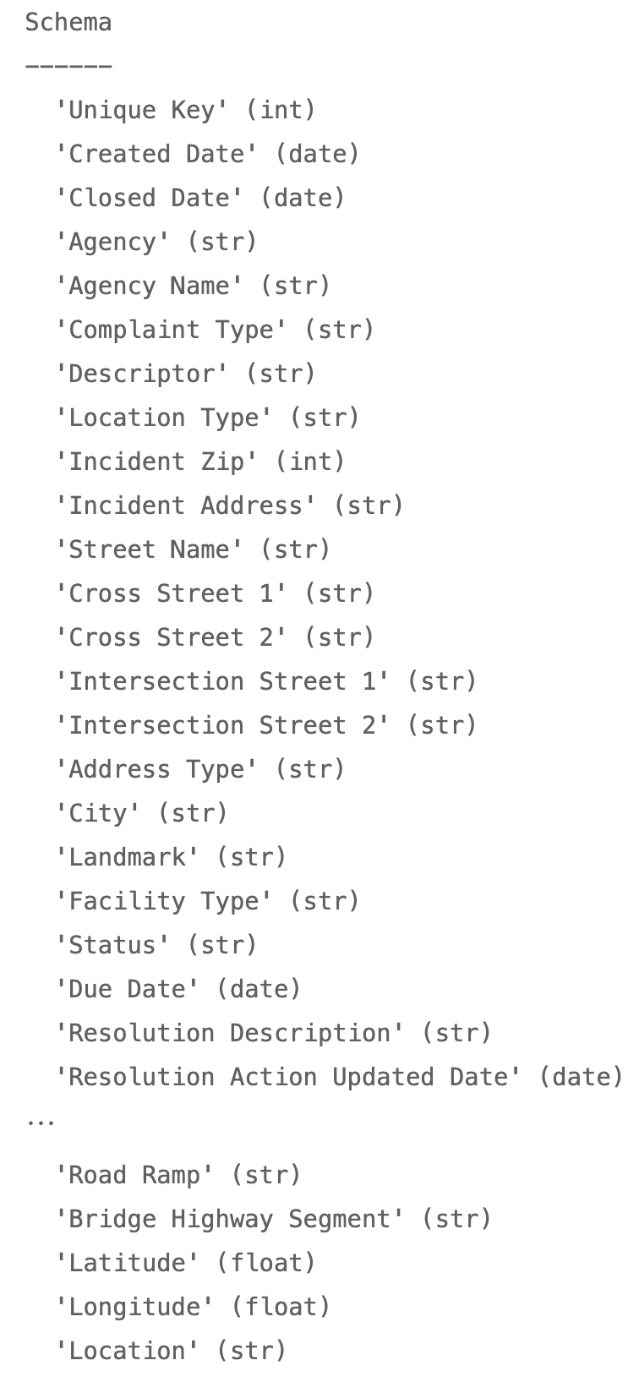
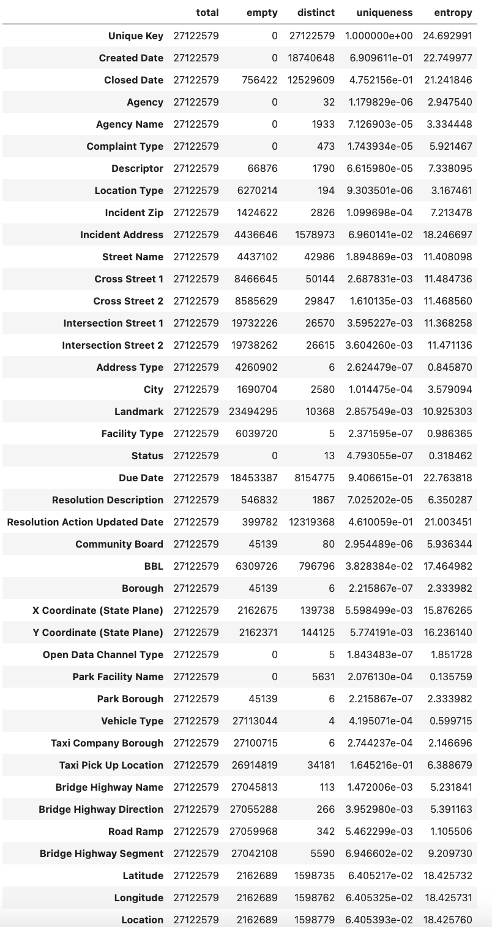


Data Profiling
What am I trying to accomplish?
What kind of data do I need?
What kind of dataset am I dealing with?
How can I improve the dataset?
What tools and techniques should I use?

Slide 5
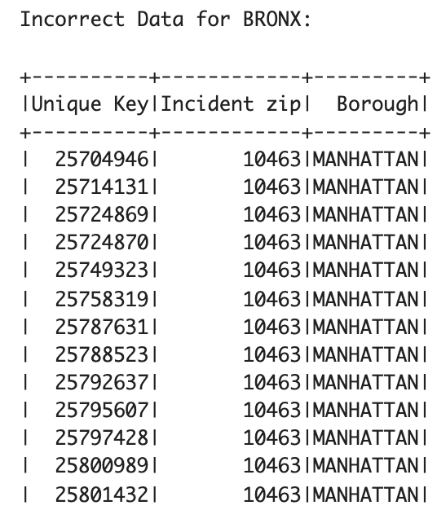
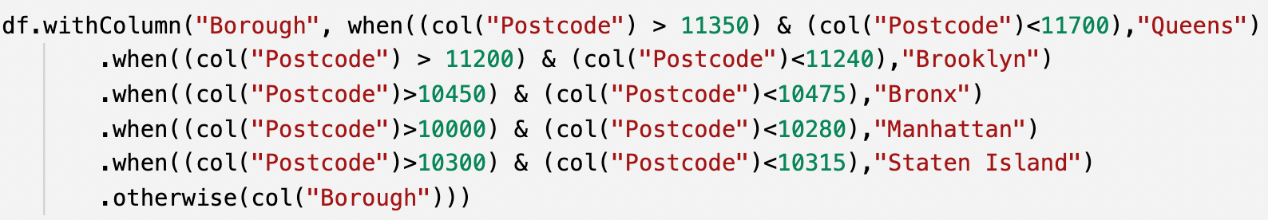
Functional Dependencies - Zip code to borough mapping
Which data is most likely to be wrong? Which process is the most error-prone?
Strategy: bound each borough by a pair of min-max zip codes

Slide 6
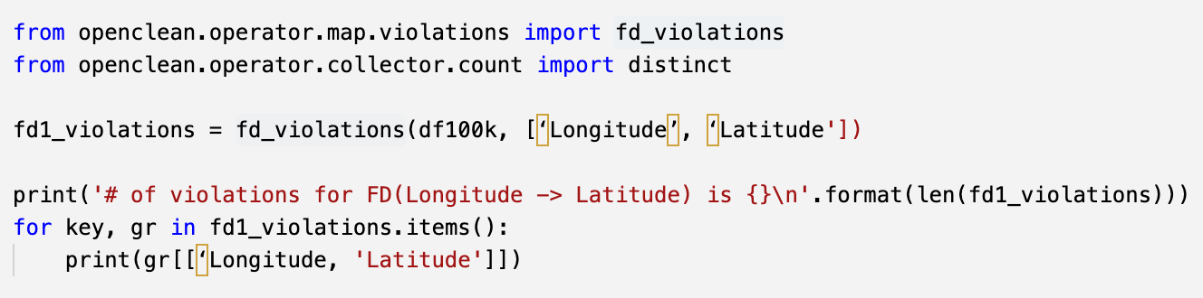
Functional Dependencies - LongLat mapping with Borough
Which part of the data is the most reliable?
Strategy: identify correct boroughs based on the geographic attributes (e.g. latitude, longitude)

Slide 7
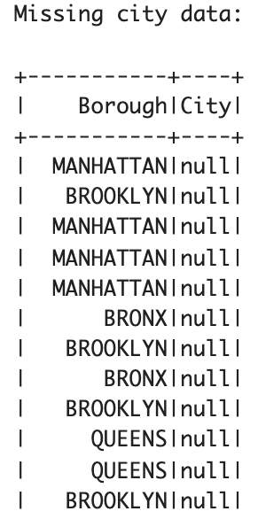
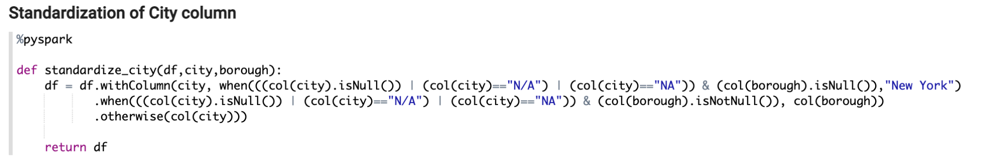
Missing Data cleaning and Standardization
After cleaning the boroughs, we apply cleaning and standardization of City column.
If city column has missing data like“null”, “NA”, “Unspecified” or “N/A”.
Check for borough data since the data set uses them interchangeably.
If there is data in borough we update the city column with Borough name else we can generalize the city and set it to “New York”.

Slide 8
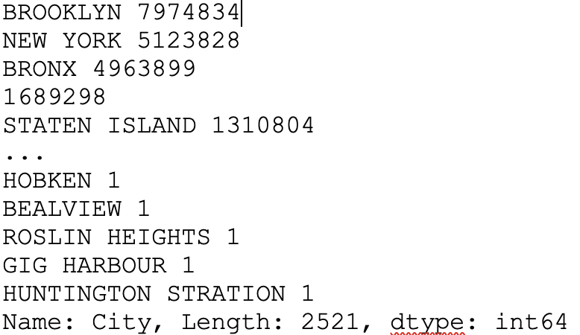
Outlier and Anomaly Detection
Since the data is for New York City, so in order to find out outlier, we have used city column from the data set.
By counting the values corresponding to each city, we were able to get all the requests that did not belong to New York City.
Therefore, by detecting all the outliers, we cleaned the city column by removing all requests other than those of New York City, Brooklyn, Manhattan, Queens, Staten Island and Bronx.
Outlier based on frequency of city

Slide 9
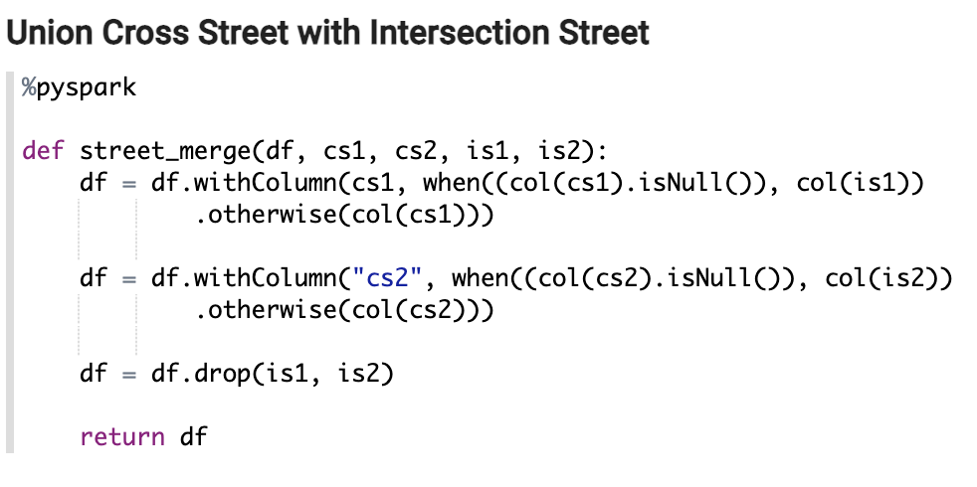
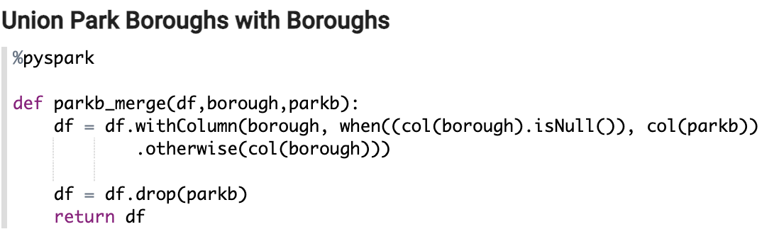
Data cleaning using Union architecture
Here we are using union of similar columns to remove redundancy.
Observation- If data is present in “Cross Street 1” and “Cross Street 2”, then the data in “Intersection Street 1” and “Intersection Street 2” columns is missing, and the vice versa.
This holds true for “Borough” and “Park borough” columns as well sometimes.
Performed union on these similar column. After that we drop the redundant columns.

Slide 10
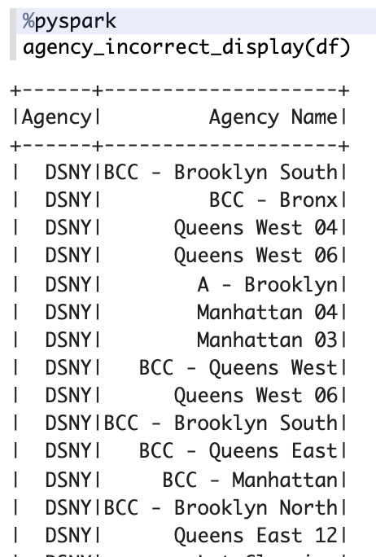
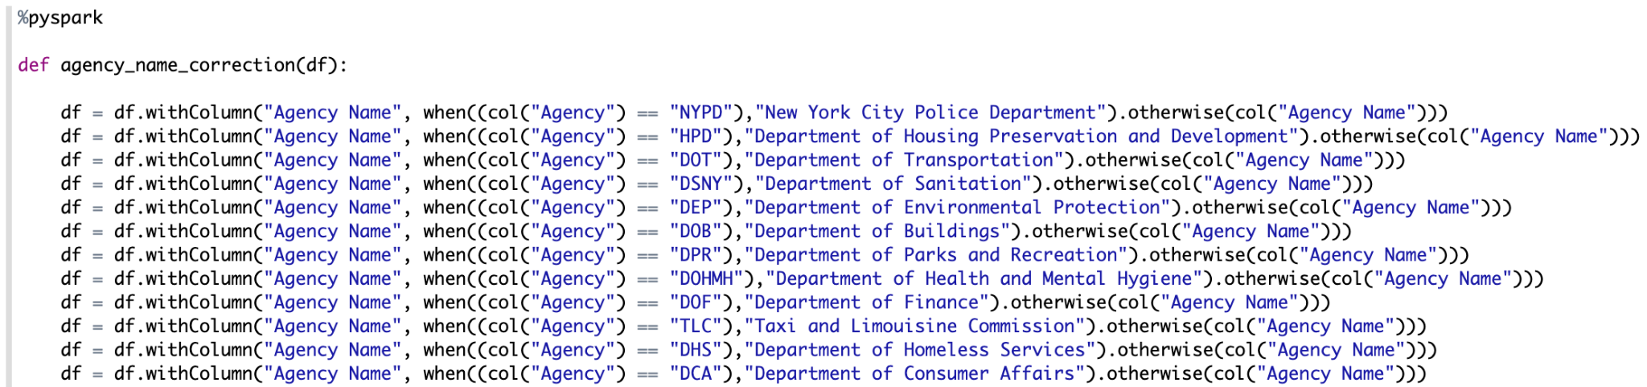
Agency to Agency Name mapping
Agency column represents the acronym of the agency and Agency Name column which represents the full name of that agency.
In order to have correct names of the agency mapped with their acronym, we implemented the mapping for all 32 distinct agencies acronyms with corresponding agency names.

Slide 11
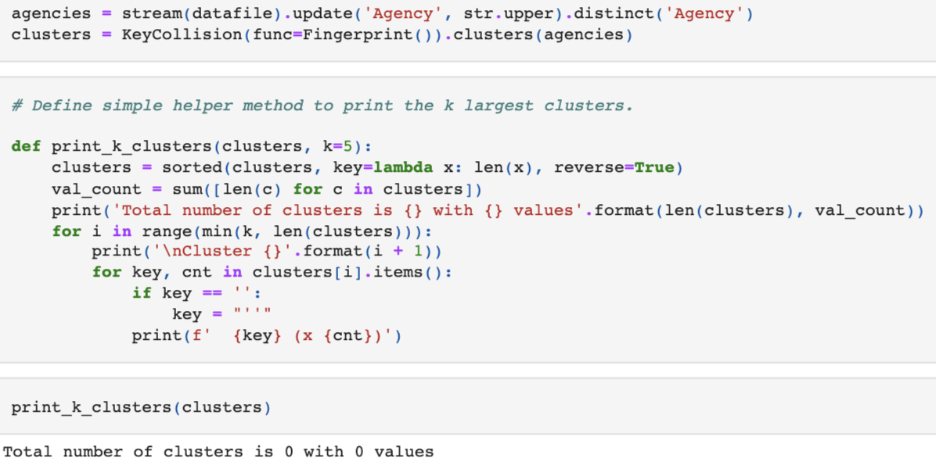
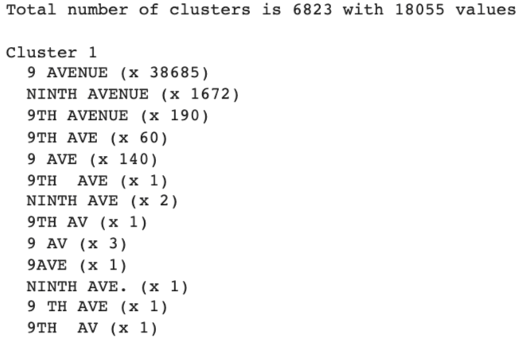
Data Standardization using Key collision clustering
We applied key collision clustering on the columns like “Agency” and “Street Name”. Using this, we standardized these columns.
Interesting observation was made based on key collision clustering for Agency column.
The agency column in the data set was the most clean. There were zero clusters formed with no conflicts in the data.
Zero clusters for Agency column
Clusters for Street column

Slide 12
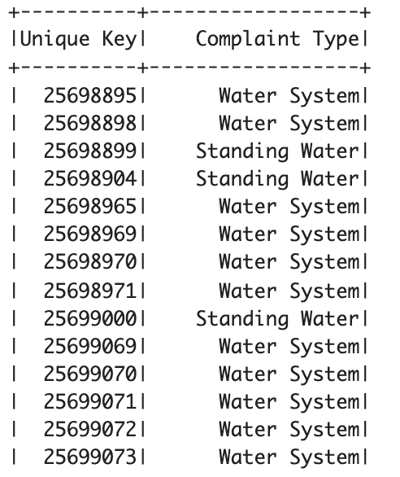
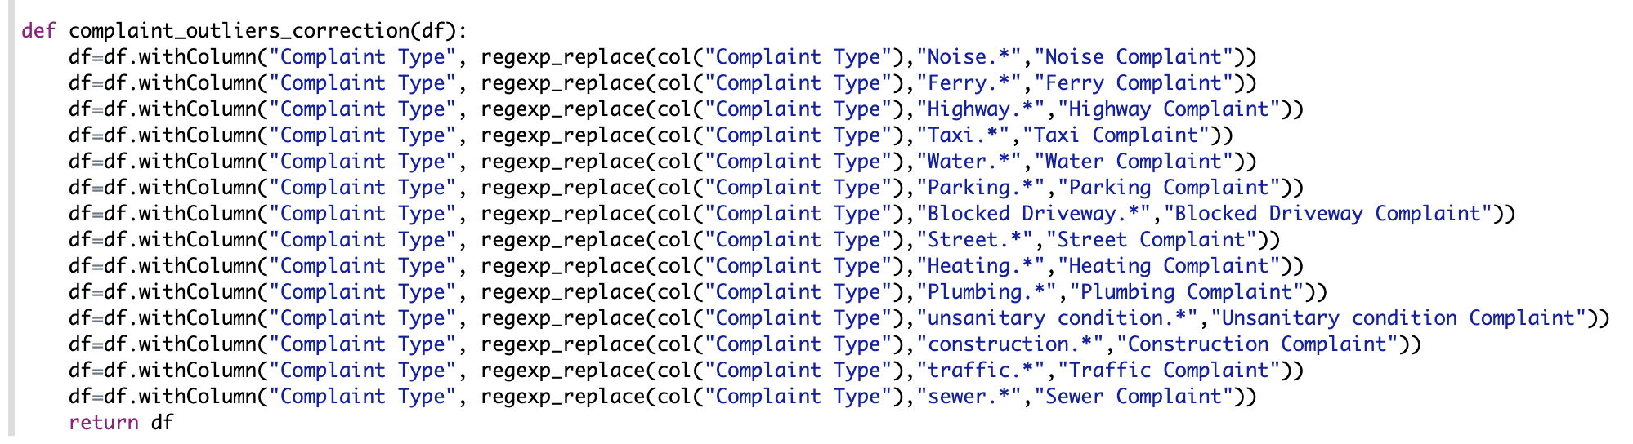
Data Generalization - Complaint Type
Implemented technique which generalizes similar types of complaints under one umbrella using regex.
One to many mapping of complaint type by clustering similar complaints together.
For example, there are different complaints related to water problems. So we generalized all water related complaints with the name “Water Complaint”.

Slide 13

Creating Reference Data
After cleaning the overall size of the dataset decreased by 1 GB.
We’ve also ensured that no essential information was lost during the cleaning process.

Slide 14
Other Datasets
Dataset Name | Matching Columns | Cleaning Techniques
Flu Shot Data | Zip Code, Borough | Validation of Zip Code to Borough functional dependency
NYPD Complaint Data Historic | Created Date, Borough, Park Facility Name, Latitude, Longitude, Location, Descriptor | Identifying rows with invalid dates (e.g dates in the future) Dropping duplicate data (e.g. X & Y coordinates, Longitude and Latitude)
NYPD Arrests Data | Closed Date, Descriptor, Borough, Latitude, Longitude | Identifying rows with invalid dates (e.g dates in the future) Dropping duplicate data (e.g. X & Y coordinates, Longitude and Latitude)
Shooting Incident Data | Created Date, Latitude, Longitude | Dropping duplicate data (e.g. X & Y coordinates, Longitude and Latitude)
Bikes in Buildings Requests | Street Name, City, Post Code, Borough, Request Date | Validation of Zip Code to Borough functional dependency Identifying missing city names Identifying invalid dates
NYC Wi-Fi Hotspot Locations | Borough, Latitude, Longitude, X, Y, City, Postcode, Location | Validation of Zip Code to Borough functional dependency Identifying missing city names Identifying invalid dates Dropping duplicate data (e.g. X & Y coordinates)
NYPD B Summons | Date, City, X Coordinate, Y Coordinate, Longitude, Latitude | Identifying missing city names Identifying invalid dates Dropping duplicate data (e.g. X & Y coordinates, Longitude and Latitude)
Housings New York Units by Building | Street, Borough, Post Code, Latitude, Longitude | Validation of Zip Code to Borough functional dependency Identifying invalid dates

Slide 15
Precision and recall
Precision - Precision is described as the fraction of times the technique/model classifies the number of cases correctly.(TP/TP+FP)
Recall - It is a measure of utility, which means that it identifies how much the model finds of all that there is to find within the search space. (TP/TP+FN)
Zip Code - Borough Mapping Issue:
The recall is lower than 100% in this case due to the fact that the Zip Codes that are wrong and are mapped to correct Boroughs, the zip codes are not being corrected here.
Precision | Recall
1 | 0.97

Slide 16
Precision and Recall Contd…
Similarly, there is an issue in Generalization of a Complaint Type.
Precision | Recall
1 | 0.87
We found in our selected sample that, that although the precision of was 100%, the recall is as low as 87% because, the type of complaint which does start with Eg. Noise but is a noise complaint stays untouched because it doesn't come under the Noise* regex.

Slide 17
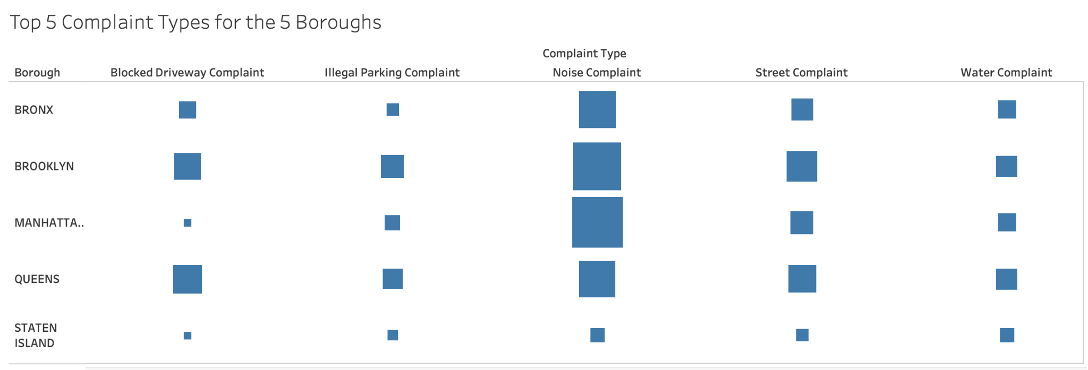
Why do we clean our data?
What are the top 5 Complaint Types for the 5 boroughs in 311 Service Requests?
How does it help?

Slide 18
Thank you!!
Happy to answer any questions :)
We are especially grateful to Prof. Juliana Freire for all guidance and support in this project!

